Slide 1
Working with Kanban

Slide 2
Visual Management in Agile
Visual Management is one of the strongest tools to stimulate collaboration and ensures that the pitfalls are uncovered. The tool helps ensure the work done by a team is constantly visible on manual or electronic boards.
It also helps:
Identify work and impediments.
Communicate important information
Show how to perform a task.
Show planning and priorities.

Slide 3
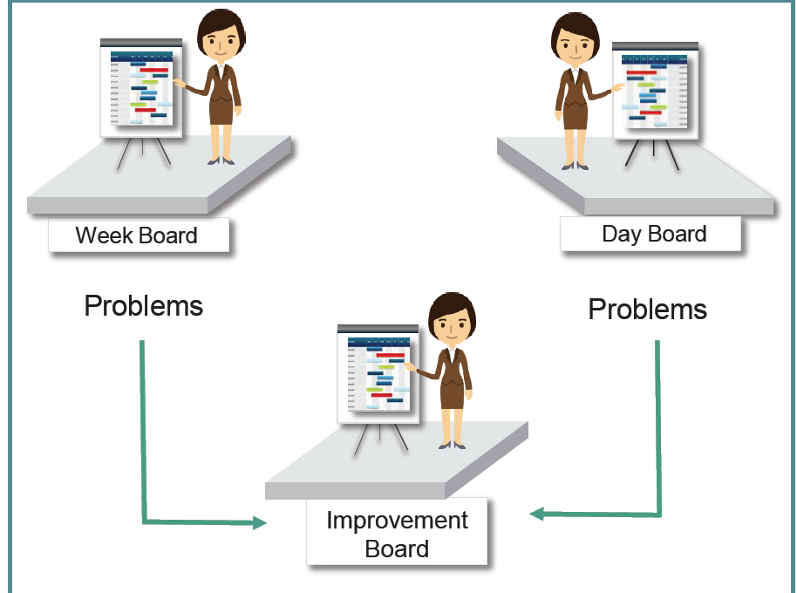
Visual Management: A Key Tool of Teambuilding

Slide 4
What is Kanban
Popular framework used to implement agile and DevOps software development. It requires real-time communication of capacity and full transparency of work.
Work items are represented visually on a Kanban board, allowing team members to see the state of every piece of work at any time.
Kanban is a signaling system that identifies when a new work can enter the system.
It helps establish single-piece-flow to ensure flow of value and keep the team free from getting overloaded with work.

Slide 5
Kanban Board
An agile project management tool designed to help visualize work, limit work-in-progress, and maximize efficiency (or flow).
It can help both agile and DevOps teams establish order in their daily work.
Kanban boards use cards, columns, and continuous improvement to help technology and service teams commit to the right amount of work, and get it done!

Slide 6
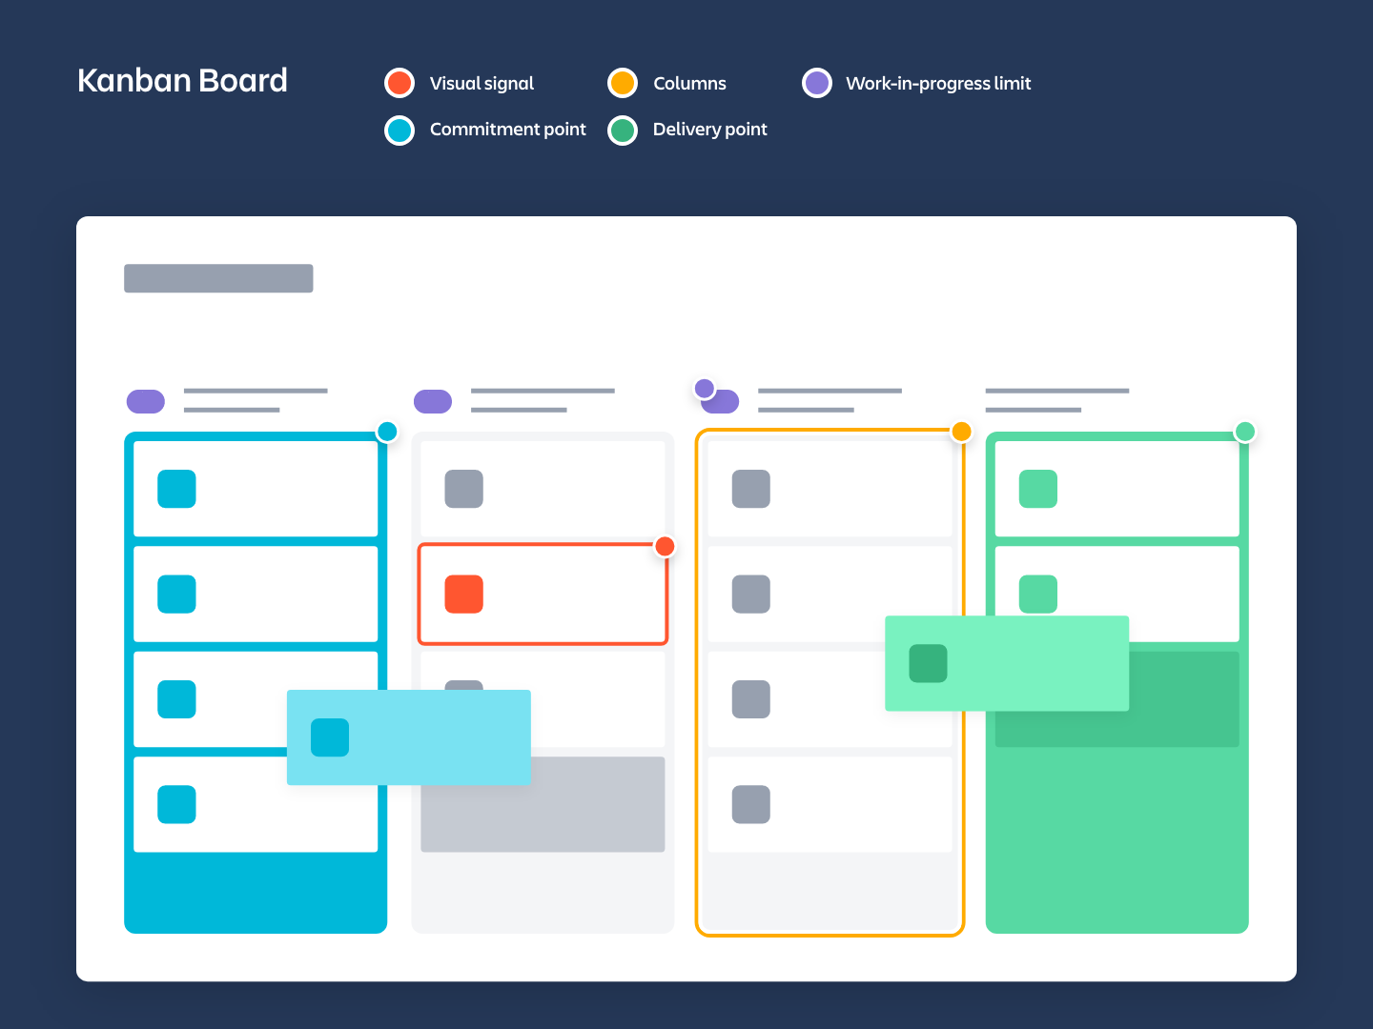
Kanban Board

Slide 7
Components of Kanban Board
Visual Signals — One of the first things you’ll notice about a kanban board are the visual cards (stickies, tickets, or otherwise). Kanban teams write all of their projects and work items onto cards, usually one per card. For agile teams, each card could encapsulate one user story. Once on the board, these visual signals help teammates and stakeholders quickly understand what the team is working on.
Columns — Another hallmark of the kanban board are the columns. Each column represents a specific activity that together compose a “workflow”. Cards flow through the workflow until completion. Workflows can be as simple as “To Do,” “In Progress,” “Complete,” or much more complex.
Work In Progress (WIP) Limits — WIP limits are the maximum number of cards that can be in one column at any given time. A column with a WIP limit of three cannot have more than three cards in it. When the column is “maxed-out” the team needs to swarm on those cards and move them forward before new cards can move into that stage of the workflow. These WIP limits are critical for exposing bottlenecks in the workflow and maximizing flow. WIP limits give you an early warning sign that you committed to too much work.

Slide 8
Components of Kanban Board
Commitment point — Kanban teams often have a backlog for their board. This is where customers and teammates put ideas for projects that the team can pick up when they are ready. The commitment point is the moment when an idea is picked up by the team and work starts on the project.
Delivery point — The delivery point is the end of a kanban team’s workflow. For most teams, the delivery point is when the product or service is in the hands of the customer. The team’s goal is to take cards from the commitment point to the delivery point as fast as possible. The elapsed time between the two is the called Lead Time. Kanban teams are continuously improving to decrease their lead time as much as possible.

Slide 9
Kanban Tasks Examples

Slide 10
Thank You

